Slide 1




Cook it yourself

Slide 2

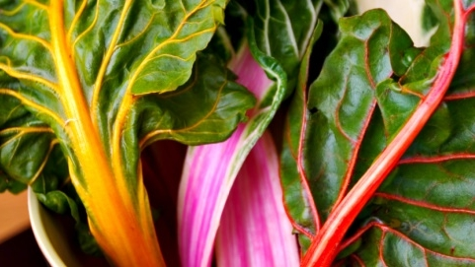

agenda
Weekly progress
Next steps
project progress

Slide 3
Weekly progress
Competence buildup in Unity
Runnable instance of Cook it yourself

Slide 4
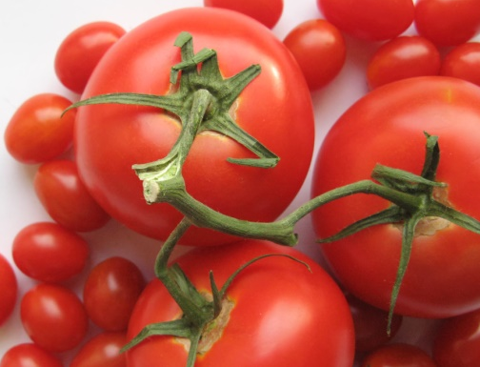
Next steps
Google Analytics integration
CI/CD setup
Disable lock screen
How to use it with wet hand
Investigate recipes

Slide 5
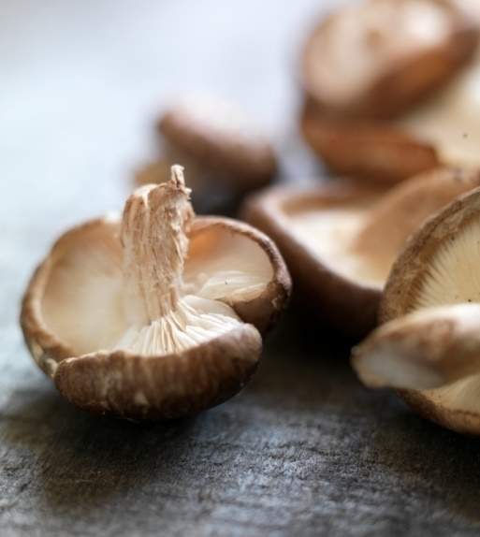
project progress

Slide 6
Thank you

